Slide 1
Exemplar Management Tool Release 2
Team 04
Kevin Schütz, Valentina Hummenberger, Julia Hammer,
Praktikum Software Engineering - SS 2021

Slide 2
Presentation Release 2 - Agenda
Current Status
Use Cases
Prototype Demonstration
Unit Tests
Plan for release 3

Slide 3
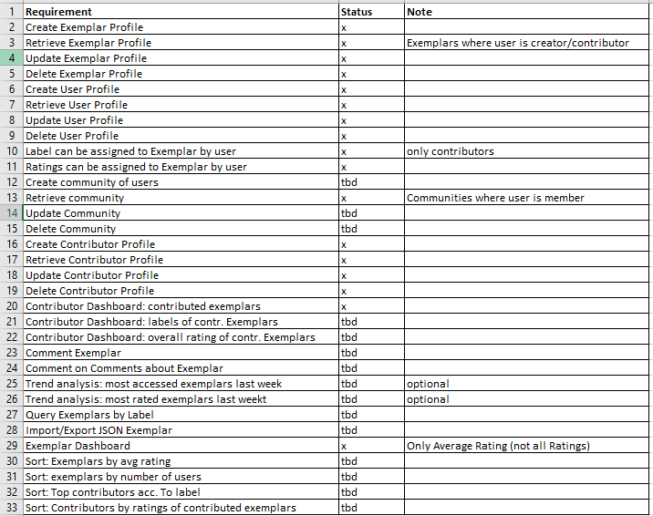
current status
Excel bei Dokuments Screenshoten

Slide 4
Use Cases
We chose use cases, which we already implemented in our Exemplar Management Tool:
Login
Create Exemplar
Edit User Profile

Slide 5
Prototype
We would like to present our Exemplar Management Tool

Slide 6
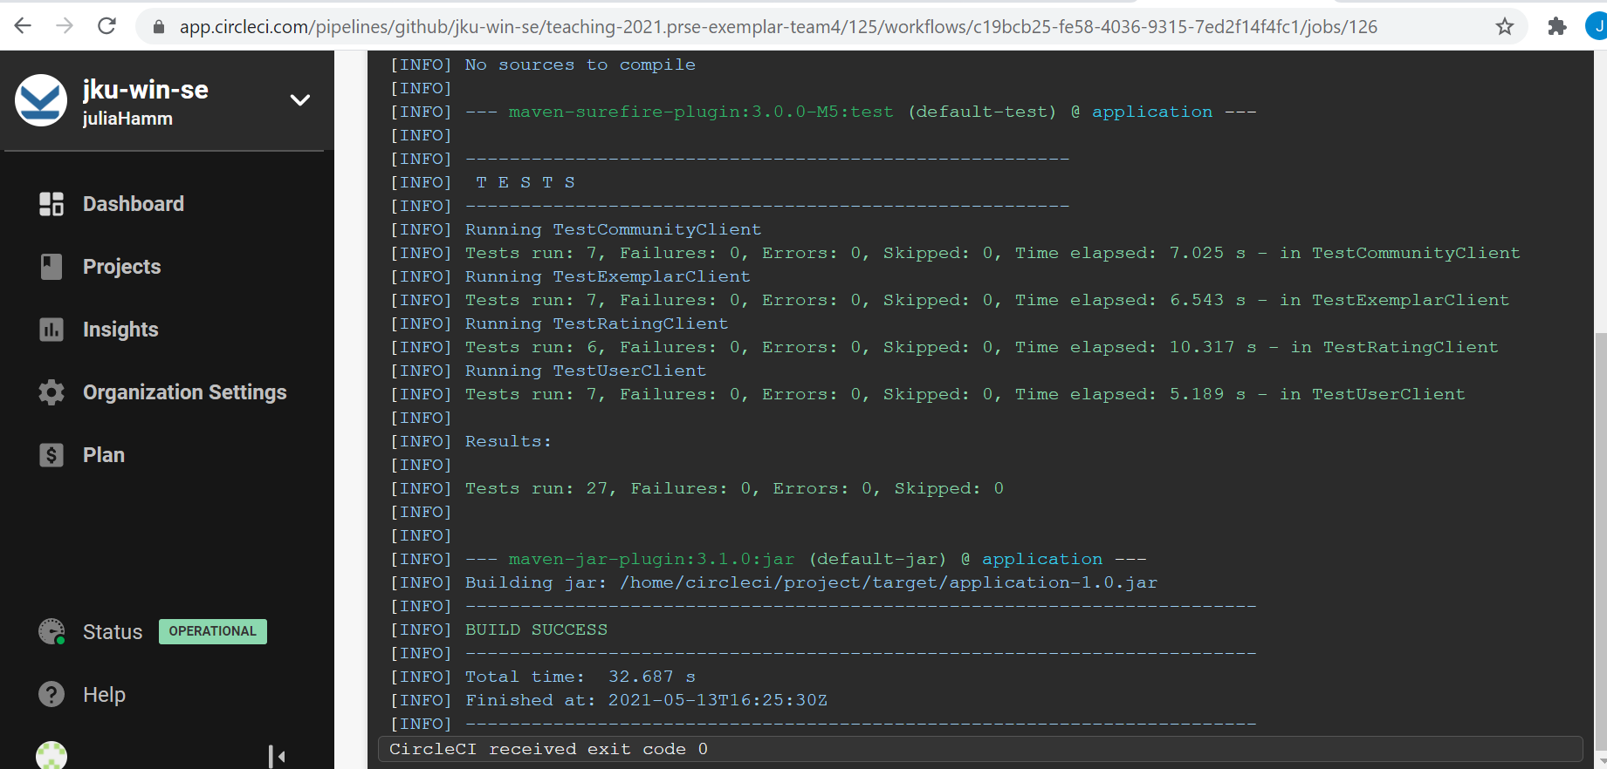

Unit Tests

Slide 7
Current Status (Redmine)+ Progress in Release 2
For the tasks we implemented, we would like to point to zenhub
We did calculate the effort it would take us to implement the tasks quite accurately. However, there is still room to improve our estimation skills.

Slide 8
Problems in Release 2
Julia had problems with the implementation of the date base, since she did not take the database courses yet. However this was not an issue as Valentina and Kevin already did the course.
There was quite a lot of documentation to do on github. We mostly worked in team meetings via zoom on github, which is why we did not contribute evenly.
We are not sure how to test the swing applications with the Unit Tests.
What is meant with „sorting exemplars by number of users“

Slide 9
Next steps+ Planing of Release 3
The next sprint will be dedicated to implement the further requirements
Unit Tests
Documentation

